Slide 1

Personalized Music Recommendation
SONGFOX
Group 2
Abhigna Mallepally | Anishka Agarwal | Edwin Daniels | Sachin Sharma

Slide 2

problem statement
How can we enhance the music streaming experience by providing recommendations that cater to individual preferences?

Slide 3
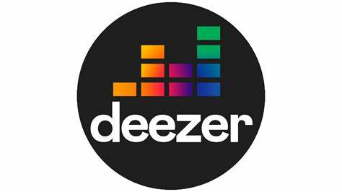








Streaming Market Overview
Market Share
Market Shifts
GenZ and Millenials spend the most on audio media and crave social, viral, and AI personalised music experiences
Consumers expect an emotionally engaging and immersive listening experience vs genre-based consumption
Generative AI is creating opportunity for content creation (audio, video, lyrics)
Pain Points
Repetitive Recommendations
Generic Personalisation
Limited Localisation
Human intervention for playlists
Emerging market depth
Notes:
must do

Slide 4
APP OVERVIEW

Slide 5







songfox
User Retention
Business Revenue
Develop an intelligent recommendation system using machine learning and advanced AI.
Personalize song suggestions based on user preferences, behavior, locale, and sentiment analysis
Live events allow users to expand their music experience from the app to the stadium
Increase user retention and business revenue for streaming platforms through better engagement.
Intelligent Recommendation
Personalisation
Live
Events
Retention & Revenue
Guest Users
AI Chat
Trending
Now
Address cold-start problems and improve engagement, especially for guest users.
The chat feature allows the user to acquire targeted recommendations
Trending Now provides users with the most viral content (global or local)

Slide 6
data source & features
Enriched Spotify 1M+ Dataset
User Listening
Sentiment Data
Captured via Spotify API.
Analyzed six audio features to define the sentiment/mood of each song in the training dataset
Locale Data
Identified languages using Llama3.1 – 8B inference model and common public datasets.
User Interaction
Likes/Dislikes,
Playlist additions

Slide 7
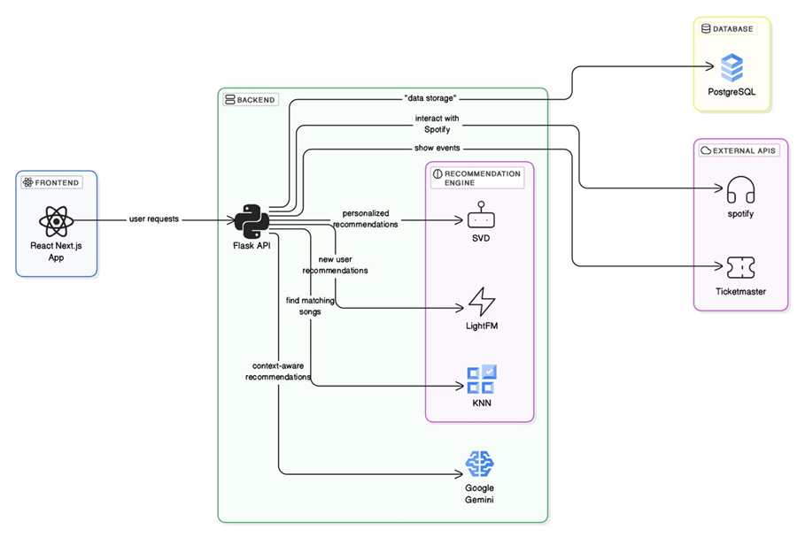
APP ARCHITECTURE
Notes:
must do

Slide 8

NEXT STEPS
Funding approach (bootstrapped or debt)
Build a Team
Build a mobile app
User Engagement
Go To Market - Marketing and Ads

Slide 9
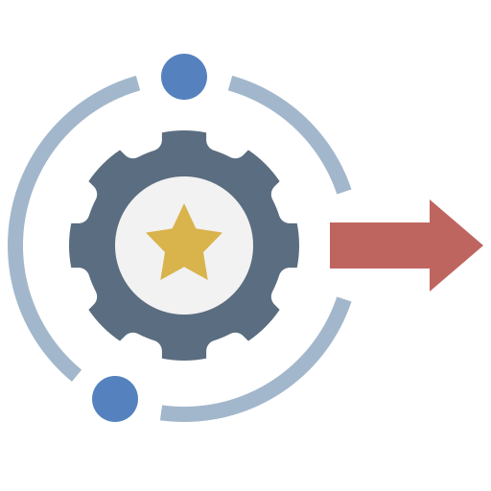
summary
Enhances user experience with hyper-personalized recommendations
Increases engagement & monetization for streaming platforms
Scalable, innovative, and adaptable for future growth

Slide 10
THANK YOU

Slide 11
APPENDIX

Slide 12
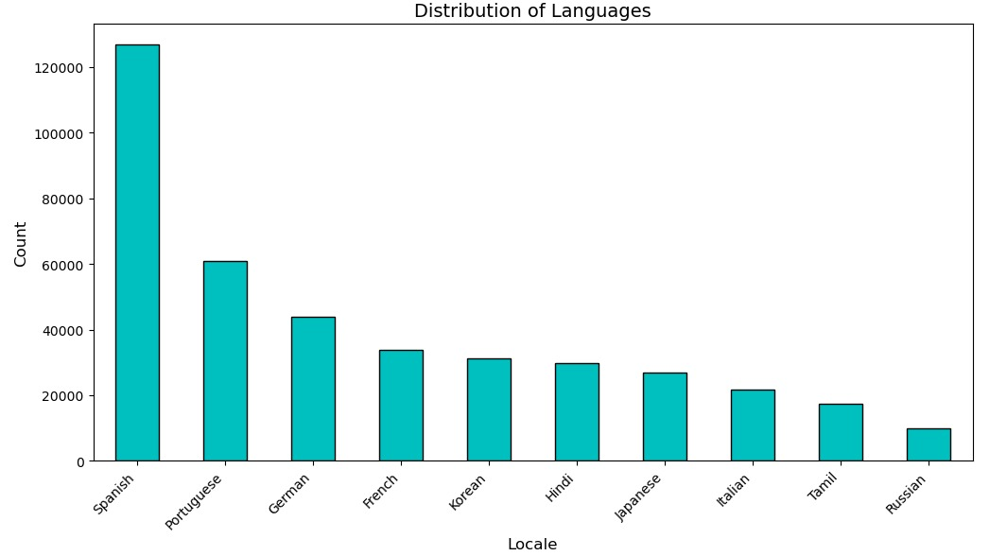
LOCALE DATA

Slide 13
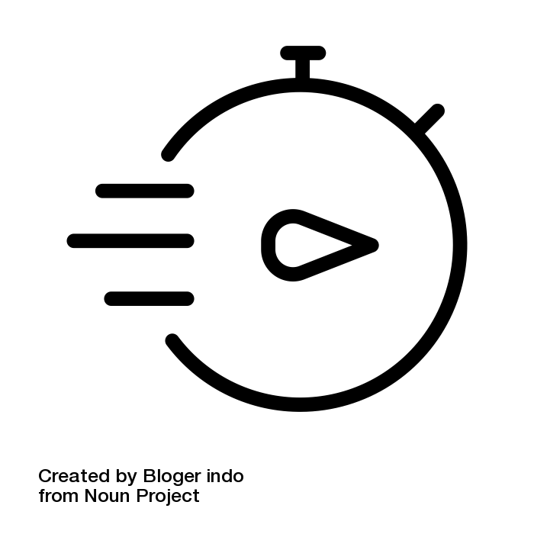



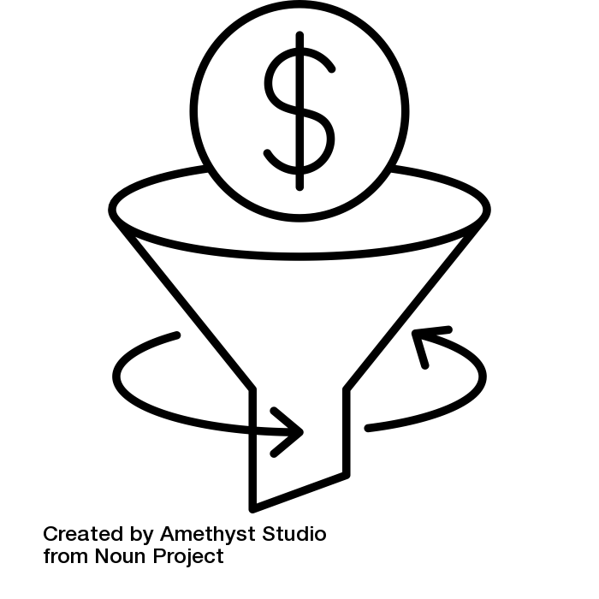
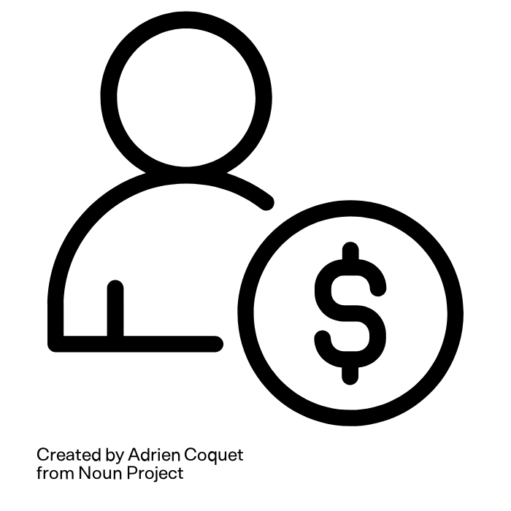
Key Metrics
<10% monthly churn
60+ min/session
70%+ user approval
Avg. Session Duration
AI Recommendation Accuracy
Churn Rate
Higher ad revenue per session ($0.02-$0.05 per session)
Higher retention & engagement → boosts premium conversion
Limits revenue loss → Sustainable growth
>50%
> 10%
> $5
User Stickiness (DAU/MAU)
Subscription Conversion Rate
ARPU (Avg. Revenue/User)
More daily users → Higher recurring engagement & ad revenue
100K users → 10K paid users ($99K/mo)
Supports revenue projections of $540K+ at 100k users

Slide 14
Competitive Gap
High
Low

Slide 15
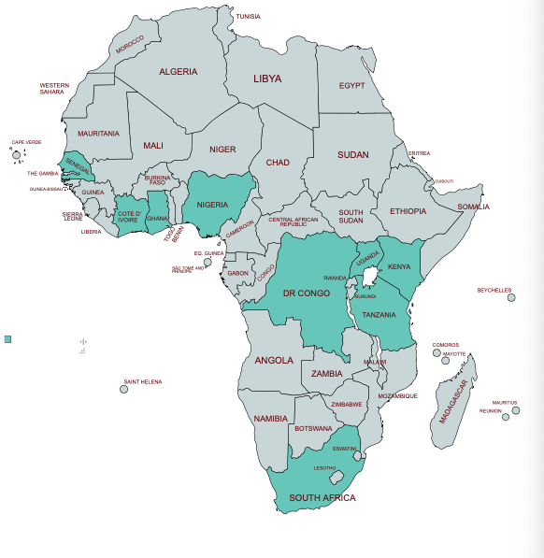
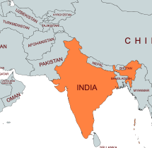
TARGET Market
Africa
South Africa, Nigeria, Kenya, Uganda, Tanzania, DRC, Ghana, Senegal
India
Africa’s Music Streaming market is projected to grow 3x by 2030, with local genres underserved (Afrobeats, Amapiano)
India alone has 200m+ music streamers but foreign music streaming services have struggled to localize beyond “Indian” as a genre

Slide 16

Market Validation
Why these markets?
High mobile penetration (80% smartphone adoption by 2030)
Large population of young listeners (18-35) with strong demand for local & regional music
Low-cost ad-supported models thrive - very price sensitive market
AI-based curation helps overcome language and cultural barriers
Market Considerations
Affordability Constraints:
Nigeria: Min wage ≈ $46/month → Ideal price: $0.50 - $1/month
India: JioSaavn & Gaana charge ±$1/month
South Africa & Kenya: Can handle $1.50/month, but still price-sensitive
Payment Infrastructure Challenges:
Credit card penetration is low (5.5%), so in-app purchases via Google Pay or UPI

